Slide 1
Indicators of Economic performance
worksheet

Slide 2
Definition Trend
Changes or developments that are happening within a particular field.
NO changes in a market
Social media

Slide 3
Definition Trend
Changes or developments that are happening within a particular field. 
NO changes in a market
Social media

Slide 4
Definition Economic growth
Decrease in the size of a country's economy over a period of time
An increase in the size of a country's economy over a period of time
Fall of the size of a country’s economy over a period of time

Slide 5
Definition Economic growth
Decrease in the size of a country's economy over a period of time
An increase in the size of a country's economy over a period of time 
Fall of the size of a country’s economy over a period of time

Slide 6
Definition Quantitative indicator
Quantitative indicators are reported as photographs and images
Quantitative indicators are reported as words, phrases or sentences
Quantitative indicators are reported as numbers, such as units, prices, proportions, rates of change and ratio

Slide 7
Definition Quantitative indicator
Quantitative indicators are reported as photographs and images
Quantitative indicators are reported as words, phrases or sentences
Quantitative indicators are reported as numbers, such as units, prices, proportions, rates of change and ratio 

Slide 8
Sustainable economic growth
True or False
Sustainable economic growth means having a rate of economic growth that: Does not have significant pressure on prices of goods and services.

Slide 9
Sustainable economic growth
Its True
Sustainable economic growth means having a rate of economic growth that: Does not have significant pressure on prices of goods and services.

Slide 10

Limitations of GDP
https://www.youtube.com/watch?v=hBqWRayc1kE

Slide 11

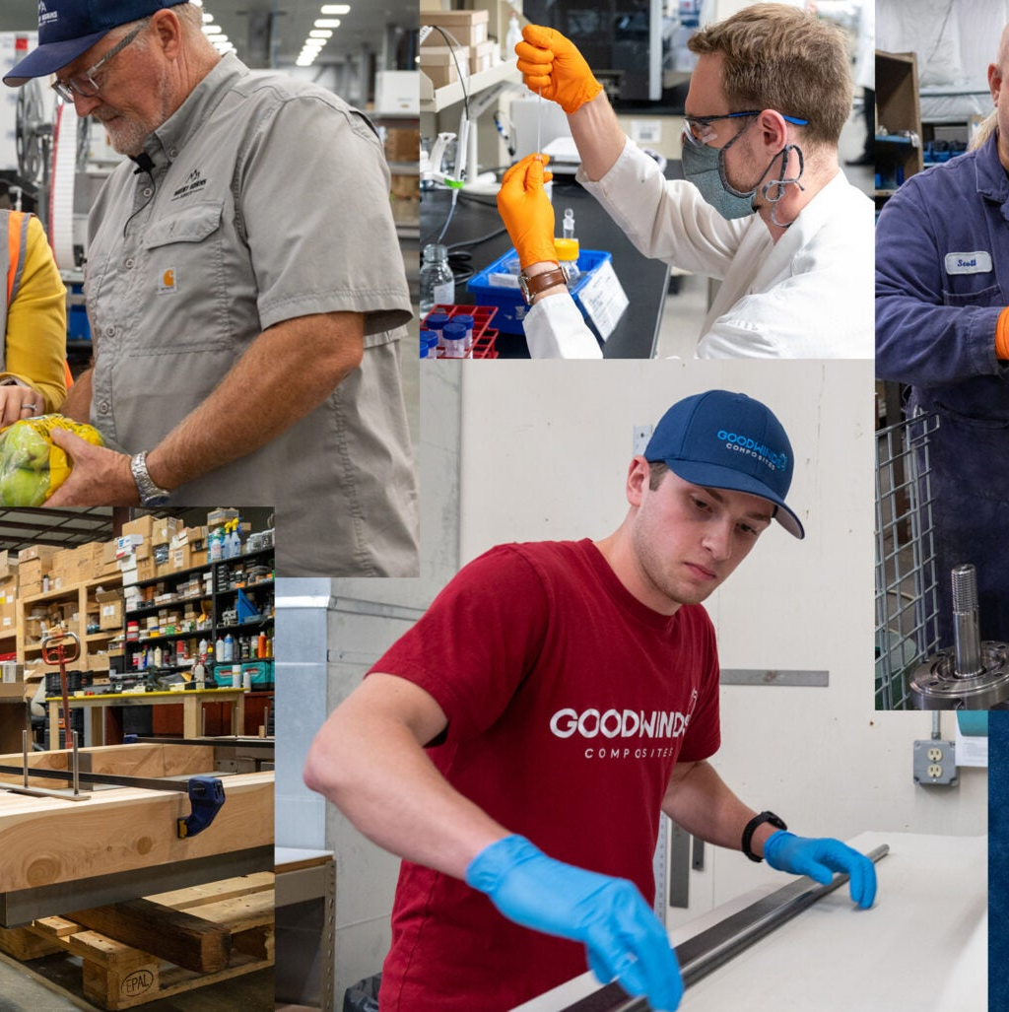
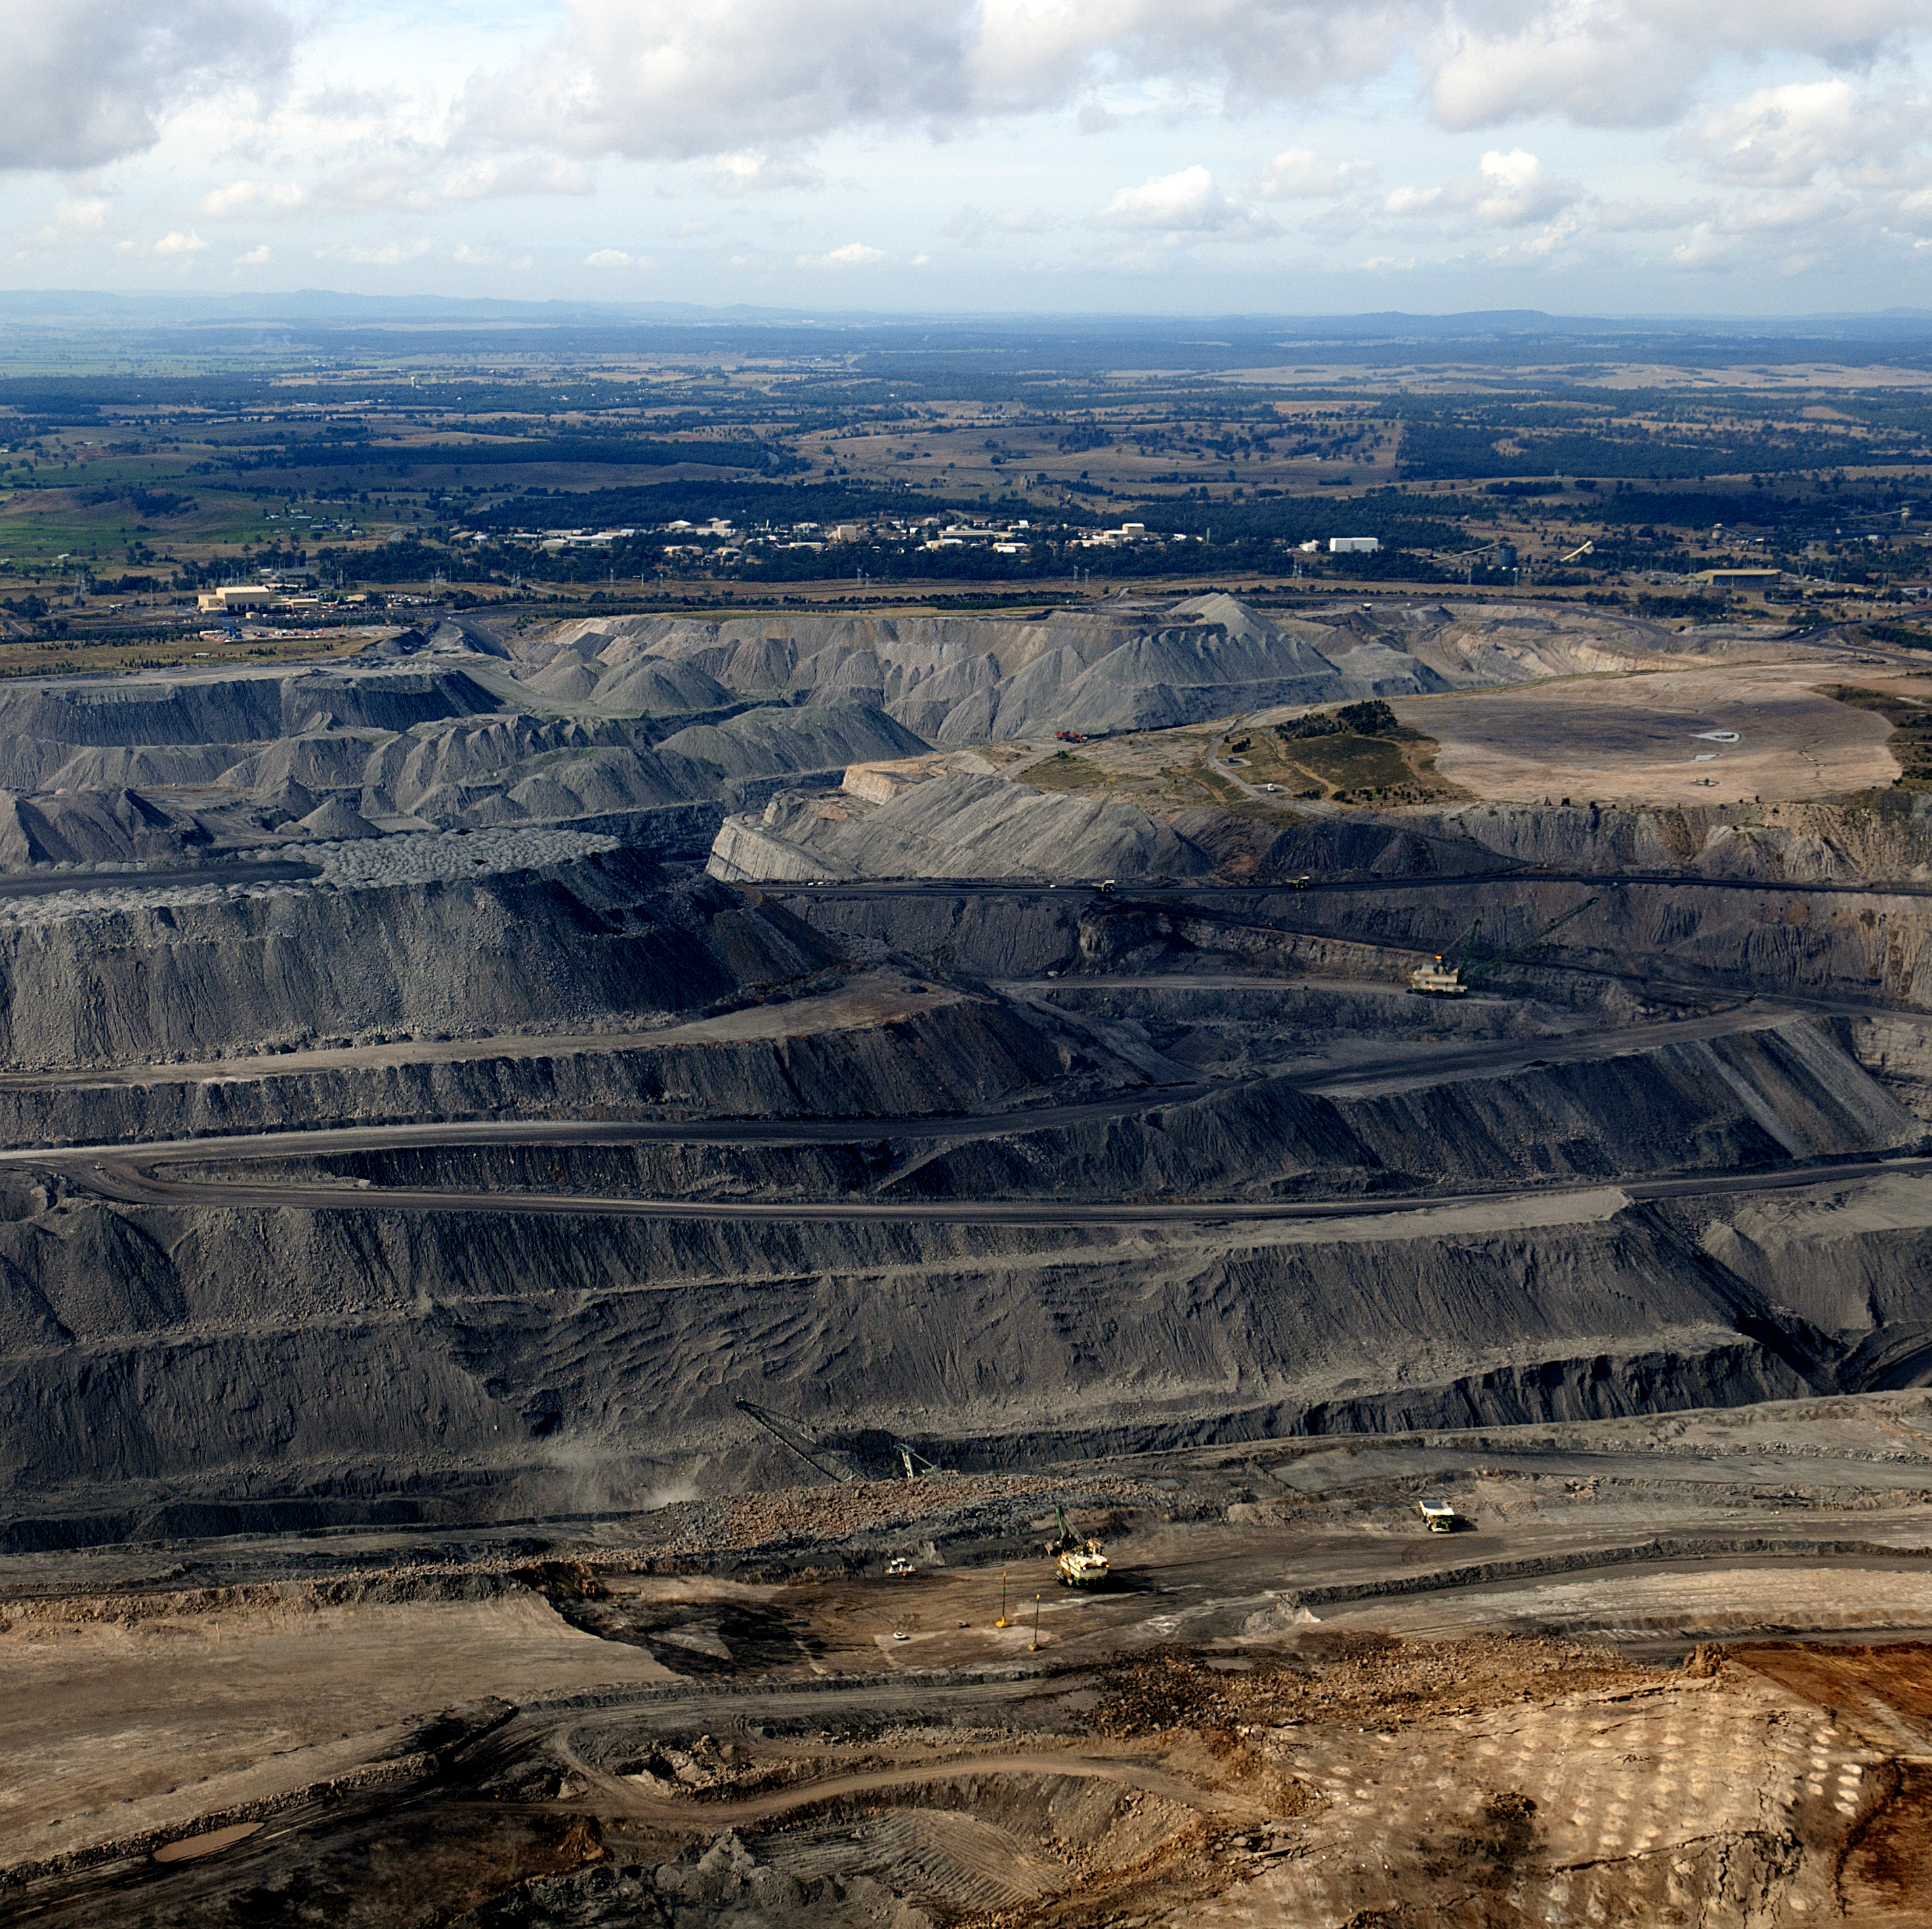
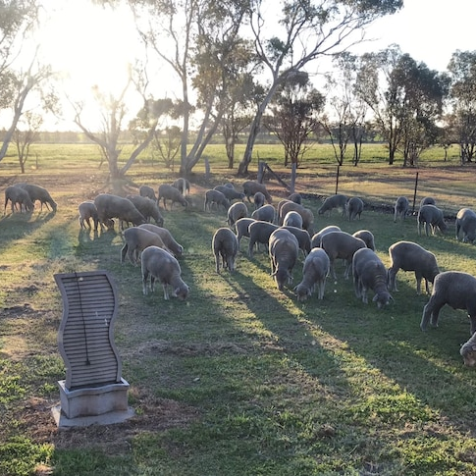
Included in GPD
Primary sector
Secondary sector
Service sector

Slide 12


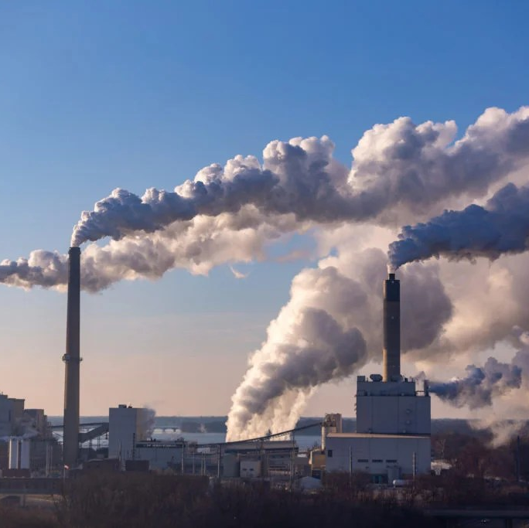
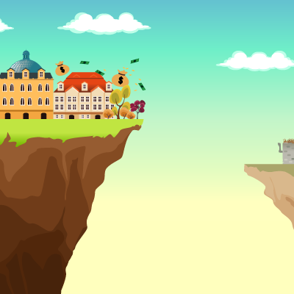
Not Included in GPD
Inequality
Pollution from goods and services
Informal businesses e.g. baby sitting
Home labor
Volunteer

